Slide 1
How can Teachers use Audio in the Classroom?
Josh Freedman

Slide 2
Audio in the classroom
Audio can be used in the classroom in many ways. The following list are some ways we use audio in the classroom:
Play classical music while students are working.
Help introduce new topics.
Hook students into a lesson.
Have them playing in backgrounds of presentations.

Slide 3
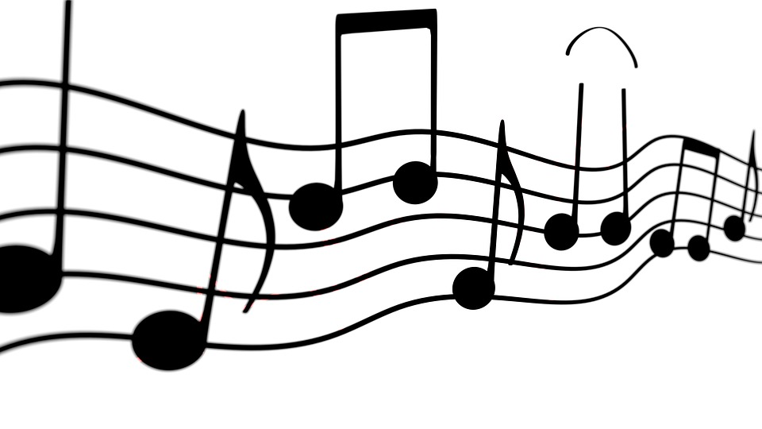
What do you mean?
Teachers can use up to 10% of a copyright musical composition may be reproduced, performed, and displayed as part of a multimedia program produced by an educator or students.
This means that you cannot use an entire song for educational purposes without the proper licenses or permission.

Slide 4
How can I use audio in my classroom?
We will now explore three different scenarios that will include audio use. As a table, discuss if think the audio being used in the classroom is covered under copyright and fair use laws, or are they breaking the copyright law.
OR

Slide 5
Scenario One
I want to use my favorite song as background to a video I am creating for class. So I decide to copy the entire song and use in my video. My video will be posted on my website for students and others to view.
What do you thing? Did I break a copyright law?

Slide 6
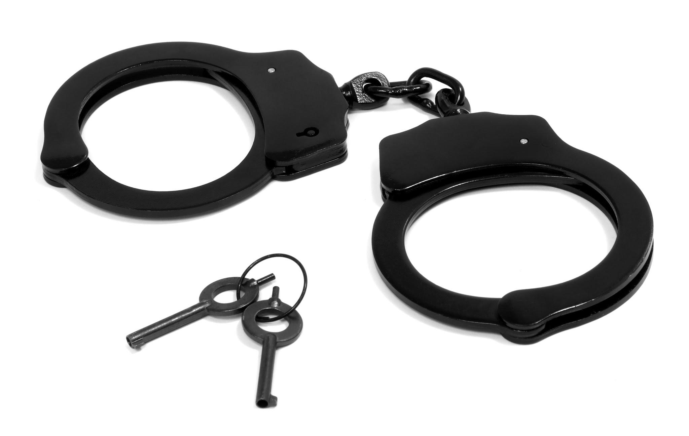
Scenario One Continued
The answer is yes they did break a copyright rule. You cannot post audio that is copyrighted and make it available for the world to view. If you needed a password to view my website, then that would be allowed because only your students would have access to your page. Overall, putting background music to a presentation or video is not considered educational use.

Slide 7
Scenario Two
A classroom is earning about the 1920’s and the 1930’s. The teacher wants the students to listen to musical works from those time periods. They go to the media center and check out two CD’s that they will have the students listen to. Did this teacher break any copyright laws? Discuss with your tables.
OR

Slide 8
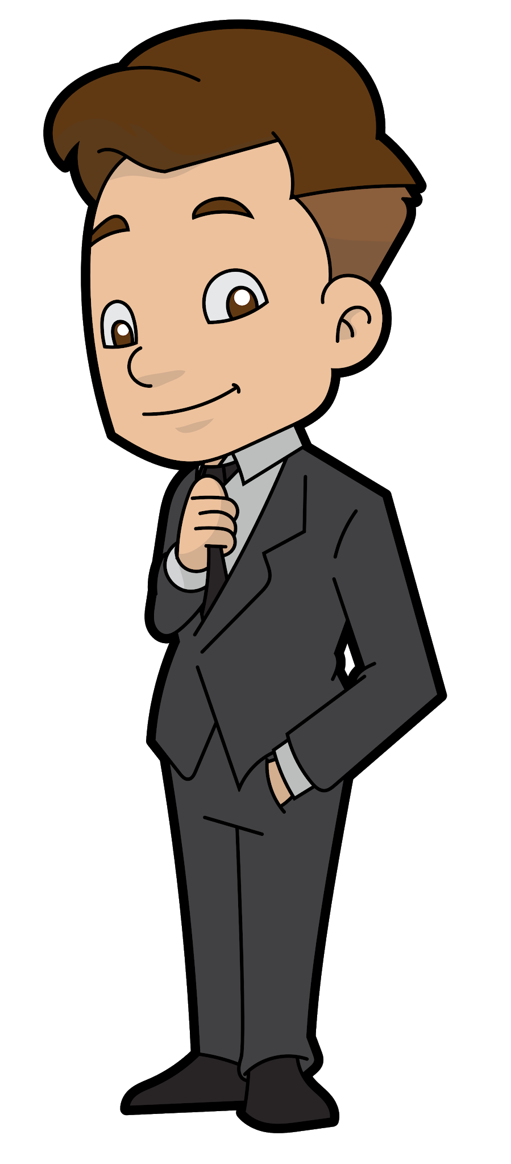
Scenario Two Continued
The answer is no they did not break a copyright law. The teacher played the songs for the classroom and that was it. They did not make copies of the songs to give to students, place the songs on their website, or illegally obtained the CD’s. The school or district paid for the CD and would be able to play if for a classroom.

Slide 9
Scenario Three
A classroom is earning about the 1920’s and the 1930’s. The teacher wants the students to listen to musical works from those time periods. That night at home, the purchase the songs they want to play for the students on itunes. The next day, the teacher plays the music for their students. Did this teacher break any copyright laws? Discuss with your table.

Slide 10
Scenario Three Continued
The answer is yes they did break a copyright law. This scenario is a surprise to many, including me. You may hear from others that the person did not illegally download the music but purchased the music legally, and should be able to use it for school purposes, the answer is still no. Actually, the purchased music legally is intended for personal or home use, and not for the teacher to play for an audience.

Slide 11
Questions or Comments
Making sure you are using audio in your classroom correctly is important. If you have any questions, or need additional information, please let me know.

Slide 12
References
Education. (2017, October 20). Retrieved from http://www.copyrightuser.org/understand/exceptions/education/
(n.d). Retrieved from http://copyright.uncg.edu/instructors/
Copyright Law: What Music Teachers Need to Know. (n.d.). Retrieved July 8, 2018, from https://nafme.org/my-classroom/copyright/copyright-law-what-music-teachers-need-to-know/
[Digital images]. (n.d.). Retrieved July 8, 2018 from https://images.google.com/?gws_rd=ssl

